Slide 1
Zero Knowledge Proofs
Eray ALTILI
06/09/2022

Slide 2
Why IT Matters
The first benefit of zero-knowledge based applications is scalability or consuming less resources to verify operations recorded on a blockchain. It’s fairly obvious that if benefits everyone.
Private computation has countless respectable applications, but let us highlight the potential benefits for digital finance:
Data protection: Client identifiable information (CID), financial balances, and metadata would remain private.
Compliance: Privacy is not (necessarily) a device to evade regulatory compliance. Instead, it can be an enabler, by enforcing need-to-know and segregation of duties at a technical level.
Applications: Where most regulated institutions currently limit their use of blockchains to relatively basic tokens, they could now perform more complex operations on-chain at a reasonable cost.

Slide 3
Zero Knowledge Proofs
One party (Prover) can prove that a specific statement is true to the other party (Verifier) without disclosing any additional information.
A zero-knowledge proof (ZKP) is a mathematical technique to verify the truth of information without revealing the information itself
What makes zero knowledge proofs so special is the ability to share proofs without sharing data. While data is kept privately and remains under the control of its owner, proofs can be publicly shared and verified.

Slide 4
Zero Knowledge Proof Use Cases
Finance: ING uses ZKPs that allow customers to prove that their secret number lies in a known range. For example, a mortgage applicant can prove that their income is in the admissible range without revealing their exact salary.
Online voting: ZKPs can allow voters to vote anonymously and to verify that their vote was included in the final tally.
Authentication: ZKPs can be used to authenticate users without exchanging secret information such as passwords.
Machine Learning: ZKPs can allow the owner of a machine learning algorithm to convince others about the results of the model without revealing any information about the ML model itself.
Notes:
Where Can You Use ZKP?
ZKP or zero knowledge proof use cases need to be able to work with cryptography and trustable devices. Compared to other devices mobile seems to be the correct choice here. They offer a safe runtime environment compared to browsers. However, it’s not still out of risk.
But the main question is where can you utilize zero knowledge proof use cases?
Messaging
In messaging end-to-end encryption is necessary. So that, no one can read your private messages without the client itself. Two users have to verify their trust to the server and vice versa. On the other hand, ZKP provides that end-to-end trust without leaking any extra info. With the help of ZKP, no one would be able to hack their way to your message anymore.
This is one of the zero knowledge proof use cases.
Authentication
Zero knowledge proof can help to convey sensitive information like authentication information with extra security. Here, ZKP can maintain a secure channel for the user to use his/her authentication information without exposing it. Thus, he would be able to efficiently avoid the leakage of data.
Sharing Data
Sharing data across the internet without a third-party eye is exceptionally crucial. When you share something on the network no matter how protective they claim to be, there are always some risks.
Someone could always hack in or intercept in between sharing information — this is where ZKP can definitely help out.
This is another great one of the zero knowledge proofs use cases.
Security for Sensitive Information (Credit Card Info)
Sensitive information such as bank statements or credit card info needs an added level of protection. The bank preserves the credit card history. However, when you request the information from them, you have to communicate with their server.
Even though banks go through a secure line, still one’s credit card history is a lot more sensitive than average data. In this case, not just encrypting the whole information as one but blocks, the banks can provide better security.
Because banks would only manipulate the necessary blocks without touching other blocks, your history will get the right amount of security layer. And ZKP can provide that.
Complex Documentation
ZKP can restrict any user from accessing complex documentation that he isn’t authorized to see. As ZKP is able to encrypt the data in chunks, you will only have to manipulate certain blocks to give access, and restrict access to other users.
This way, unauthorized people won’t be able to see your documents.
Storage Protection
It can provide greater protection for your storage utility. ZKP is equipped with the protocol to keep the hackers away. With this, not only your storage unit but the information within it will also be encrypted. Not to mention the access channel too will be overly protected.
File System Control
Everything within a file system can be protected by the zero-knowledge proof protocol. The files, the users and even every login can have different layers of security. So, it can be a great use case when needed.
All of these zero knowledge proof use cases can be used in real life scenario.

Slide 5
Where Can You Use ZKP?
Messaging
In messaging end-to-end encryption is necessary. So that, no one can read your private messages without the client itself. Two users have to verify their trust to the server and vice versa. On the other hand, ZKP provides that end-to-end trust without leaking any extra info. With the help of ZKP, no one would be able to hack their way to your message anymore.
Authentication
Zero knowledge proof can help to convey sensitive information like authentication information with extra security. Here, ZKP can maintain a secure channel for the user to use his/her authentication information without exposing it. Thus, he would be able to efficiently avoid the leakage of data.
Sharing Data
Sharing data across the internet without a third-party eye is exceptionally crucial. When you share something on the network no matter how protective they claim to be, there are always some risks.
Someone could always hack in or intercept in between sharing information — this is where ZKP can definitely help out.
Security for Sensitive Information (Credit Card Info)
Sensitive information such as bank statements or credit card info needs an added level of protection. The bank preserves the credit card history. However, when you request the information from them, you have to communicate with their server.
Even though banks go through a secure line, still one’s credit card history is a lot more sensitive than average data. In this case, not just encrypting the whole information as one but blocks, the banks can provide better security.
Because banks would only manipulate the necessary blocks without touching other blocks, your history will get the right amount of security layer.
Complex Documentation
ZKP can restrict any user from accessing complex documentation that he isn’t authorized to see. As ZKP is able to encrypt the data in chunks, you will only have to manipulate certain blocks to give access and restrict access to other users.
Storage Protection
It can provide greater protection for your storage utility. ZKP is equipped with the protocol to keep the hackers away. With this, not only your storage unit but the information within it will also be encrypted. Not to mention the access channel too will be overly protected.
File System Control
Everything within a file system can be protected by the zero-knowledge proof protocol. The files, the users and even every login can have different layers of security. So, it can be a great use case when needed

Slide 6
ZKP Requirements
Properties of Zero-Knowledge Proofs
ZKPs require the fulfillment of three conditions:
Completeness: The verifier must be able to prove the existence of the complete set of information the prover claims to possess.
Soundness: The challenges with which the verifier validates the prover’s claims cannot be completed without the required information.
Zero-Knowledge: None of the actual private information may be shared between the prover and the verifier.
Zero-knowledge proofs are mostly used for applications in which privacy and security are essential. Authentication systems, for example, can employ ZK proofs to verify credentials or identities without directly divulging them. As a simple example, it can be used to verify that a person has a password to a computer system without the need for disclosing what the password.

Slide 7
What are the different types of zero-knowledge proofs?
There are two main types of zero-knowledge proofs:
Interactive zero-knowledge proofs: In this type of ZKPs, the prover and the verifier interact several times. The verifier challenges the prover who provides replies to these challenges until the verifier is convinced.
Non-interactive zero-knowledge proofs: In this type of ZKPs, proof delivered by the prover can be verified by the verifier only once at any time. This type of ZKPs requires more computational power than interactive ZKPs.

Slide 8
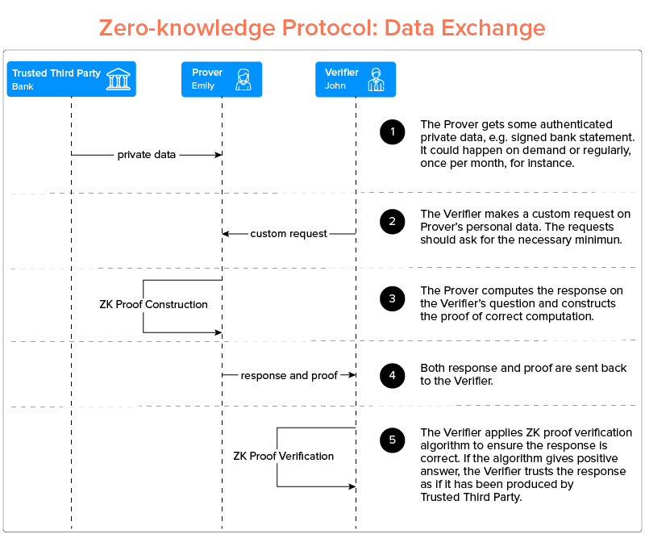
Know Your Customer – Proof of Balance What Alice needs is a way to construct proofs of her minimum balance without asking her bank to sign custom documents. What Alice needs are ZKPs. With ZKPs, the bank issues a signed statement of Alice’s balance to Alice, which she keeps secret. The statement could be of the form: ‘Alice has the amount X as of date D and time T’. In the future, Alice can use the bank’s statement to build custom proofs of requested funds as and when required. Just like regular proofs, these ZKPs are valid as long as the verifier trusts the bank and accepts that it is in reference to Alice’s fund as of a certain date and time. These proofs reveal only the data that Alice wants to be revealed: in this case, the minimum balance instead of the actual one. In effect what Alice is proving is that ‘I, Alice, have the knowledge of my statement of balance (as of a certain date and time) signed by the bank that you, the auction house, have trust in. Using that knowledge, I prove to you that I have at least the amount you are looking for.’ Thus, ZKPs allow Alice to satisfy the wishes of a verifier (the auction house) without exposing the details of her private life to neither the verifier nor the mutually trusted source of information (the bank).
Notes:
Know Your Customer – Proof of Balance
Imagine that your friend Alice would like to attend an auction as a buyer. In order to do so, she has to prove she has enough funds to make bids. One plausible solution is for Alice to ask her bank to issue a letter that confirms her available balance as of a certain date and time. The bank can do this with physically protected documents (letterheads, stamps and signatures) or their digital equivalents. The digital equivalent would naturally include a digital signature, ensuring the document was actually produced by Alice’s bank and not some elegant forger. When the action house receives the bank’s signed attestation of Alice’s balance, it can check the authenticity of the document by verifying the signature, and then examine the letter to see if Alice, in fact, has the required minimum balance.
While this protocol can be both faster, cheaper, and more secure than its physical version it inherits one particularly undesirable quirk from its ancestor. Alice is required to provide the statement in the form ‘my balance is equal to X’ instead of ‘my balance is at least Y’.
In this approach, Alice exposes unnecessary confidential information to the auction house (her actual bank balance) instead of merely satisfying the auction house’s verification needs.
We could modify the protocol in such a way that it allows Alice to give her bank a specific balance to verify for each letter. In this case, the bank’s letter would say ‘Alice has at least Y as of date D and Time T’ instead of ‘Alice has X as of date D and Time T’. While this creates a little more work for the bank, it solves Alice’s privacy problem.
Or does it? As the bank is now involved every time Alice wants to prove her balance, it now knows much more about Alice’s desires and behaviour, even before she makes any further transactions.
What Alice needs is a way to construct proofs of her minimum balance without asking her bank to sign custom documents. What Alice needs are ZKPs.
With ZKPs, the bank issues a signed statement of Alice’s balance to Alice, which she keeps secret. The statement could be of the form: ‘Alice has the amount X as of date D and time T’. In the future, Alice can use the bank’s statement to build custom proofs of requested funds as and when required. Just like regular proofs, these ZKPs are valid as long as the verifier trusts the bank and accepts that it is in reference to Alice’s fund as of a certain date and time.
These proofs reveal only the data that Alice wants to be revealed: in this case, the minimum balance instead of the actual one. In effect what Alice is proving is that ‘I, Alice, have the knowledge of my statement of balance (as of a certain date and time) signed by the bank that you, the auction house, have trust in. Using that knowledge, I prove to you that I have at least the amount you are looking for.’
Thus, ZKPs allow Alice to satisfy the wishes of a verifier (the auction house) without exposing the details of her private life to neither the verifier nor the mutually trusted source of information (the bank).

Slide 9
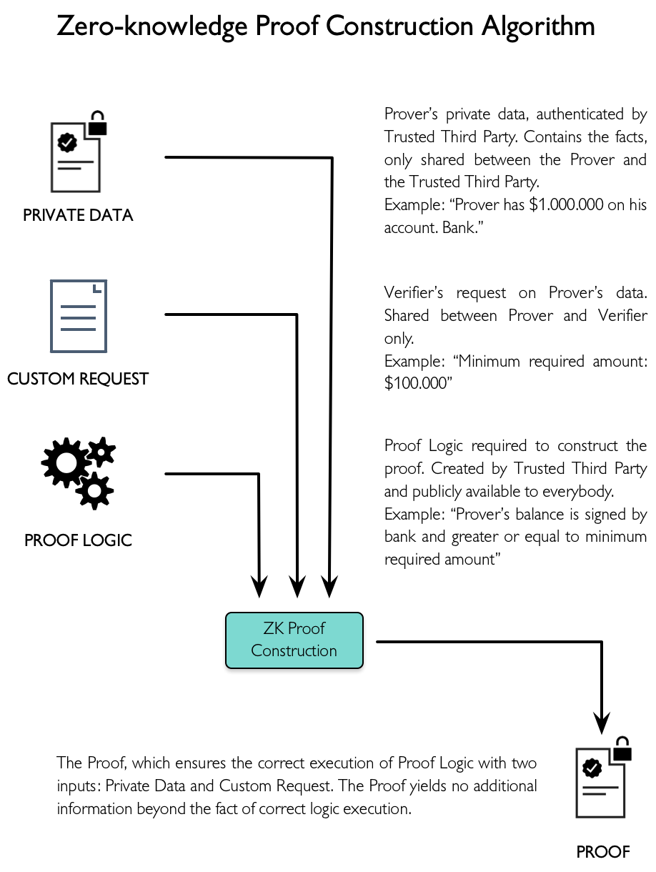
Notes:
Energy Exchange – Smart Grid
The development of US power production in the twentieth century, largely motivated by increasing economies of scale, resulted in highly-centralized modes of production, transmission and distribution of electricity. In past decades the development of efficient small-scale production and storage technologies, the demonopolization of energy markets, and increased attention on energy production’s impact on our shared environment has begun to transform the world of energy production and exchange.
The appearance of local energy producers (prosumers) restructures the traditional hierarchical model of distribution into peer-to-peer networks of energy exchange. Network models with multiple producers require more sophisticated mechanisms of load balancing and optimisation. Such networks are often called smart grids. While the data sent through a smart grid has to be detailed enough to enable the exchange, it should not expose prosumers’ confidential information.
For example, Alice, Bob and Charlie are potential prosumers on the same smart grid. The grid and its power plants are owned by Edith. Edith has installed smart meters, devices capable of measuring net energy exchange at high precision, at each of the prosumers’ houses. The data is sent to Edith’s platform in real time. She uses it to balance the grid, predict consumption and spot-trade available energy chunks.
At the same time Alice decides to personally participate in the campaign against global warming. She installs a photovoltaic system and connects it with Edith’s grid. Her solar panels produce more energy than she needs, and Edith pays her the difference.
The transition from the traditional centralized grid to such a smart grid would be a hybrid of a centralized ownership structure with a network-oriented model. However, direct exchange producers could still (and likely would) be impeded by the owner (Edith). To transform the power dynamics inherited from the centralized model, the accounting system also needs to be decentralized. With such a system, participating prosumers should be able to register peer-to-peer energy exchange transactions without additional fees, except the operational costs of running the system.
As we migrate towards a decentralized model of data exchange, an interesting issue arises: data accessibility. In a centralized model the data is protected by a single authority, and the access is regulated by means of the same authority. In a decentralized model, as there is no such authority, the transaction data is public and accessible to all users.
In our example, each prosumer’s smart meter would regularly publish that user’s consumption and production data. The messages from these meters are digitally signed by meters’ hardware security modules, and the authenticity of such messages is verified by the smart grid participants. While this system would work for accurate data tabulation, it would also reveal some details of the private lives of its participants. For example, a peak of consumption may indicate the time a person takes a shower, no consumption may hint that the household is not occupied.
ZKP technology enables the exchange of data without revealing the actual data. Our protocol is modified so that only certain data aggregates are published. A zero knowledge protocol ensures that the aggregates are computed properly with authenticated data.
In this case, Edith’s smart meters would store their signed individual readings in a secure location controlled by each grid participant. Bob would publish his aggregate power consumption on a regular basis (perhaps monthly). To verify the accuracy of his computed aggregates, he constructs and publishes a proof of consumption. The proof contains the total amount of consumed energy for a period of time chosen by Bob. The proof is built upon the original data and ensures its consistency: all measurements are present, they are correctly signed and the declared total equals the sum of individual data points. Once the proof is published on the smart grid network, it can be verified by the network participants.
Alice, a small producer, publishes her produced energy in a similar way. Bob and Alice exchange data through the network and perform transactions. The transactions reflect virtual asset movements and used for accounting purposes. Such a decentralized accounting and peer-to-peer exchange system, coupled together with a privacy preserving zero-knowledge proof protocol, enable the transition to a new kind of autonomous energy systems.

Slide 10
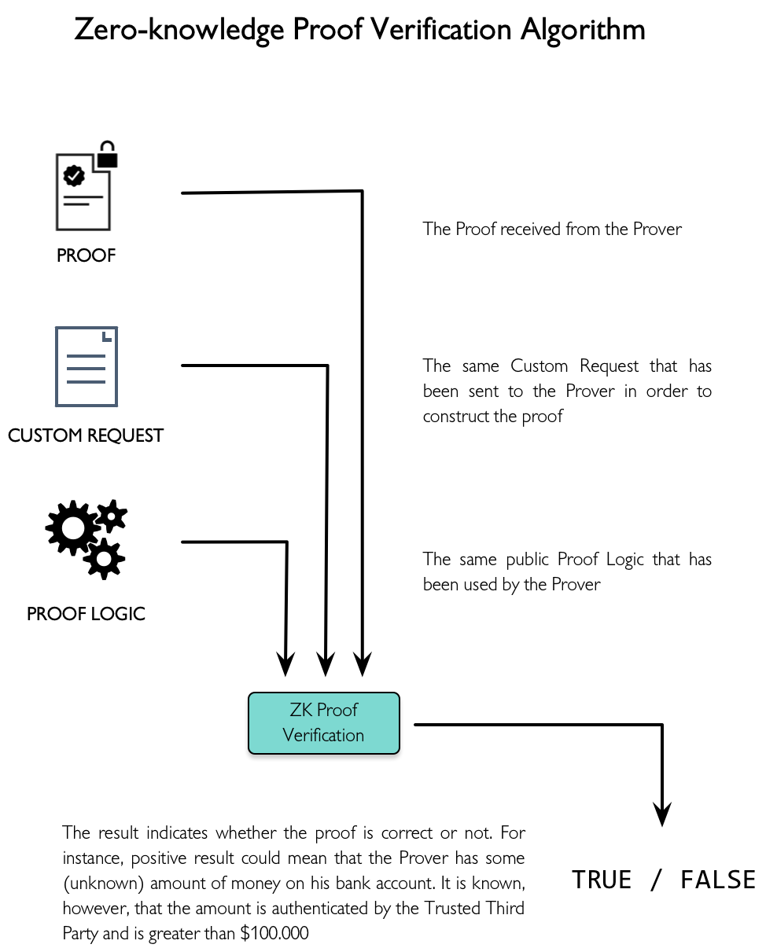
Notes:
Social Choice – Anonymous Proxy Voting
Mutual decision-making is an important part of primate society. With decision-making strategy, we need to have consensus. Consensus implies that a majority in a group are in agreement about the decision. As groups grow in number and diversity of opinion increases, consensus becomes less likely. Voting is a strategy to reach agreement without consensus, taking into account the preferences of everyone involved in the election. Though the outcome of an election is virtually guaranteed to be unsatisfactory for some of the voters, it is usually universally accepted. This is due to the voters’ trust that:
the system is worth preserving in the long-run
their votes are accurately counted
Voters tend to trust that their votes have been accurately counted if the counting is done by a trusted and neutral third party, or if it can be verified independently by any participant. Voting by a show of hands is a good example of public verifiability, whereas ballot voting relies on the neutrality of the body organizing the elections.
Another important aspect of modern voting systems is anonymity. Anonymity guarantees the freedom from being judged and persecuted, and prevents voters from being bribed or otherwise coerced to vote in a certain way (as the coercer cannot be sure the voter has voted as desired.) The drawback of anonymity is that it makes public verifiability complicated. If we try to classify voting systems, almost all of them fall in one of two categories: either anonymous but requiring the existence of a trusted neutral party, or publicly verifiable but not anonymous. A natural question arises: is it possible to build a system that is both anonymous and publicly verifiable?
Until recently, such a protocol could not be found. Intuitively, it seems that public verifiability and anonymity are contradictory. The contradiction stems from the similarity between verifiability and reproducibility. Any computation that can be reproduced can also be verified, and therefore trusted. However, we can also develop mechanisms to verify unreproducible computations. A ZKP does exactly that — it allows someone to verify a computation without knowledge of all of the inputs.
With that in mind, we add a step to a standard publicly-verifiably election to guarantee anonymity: shadow generation. In this phase, each voter would randomly generate a shadow personality, and then use a ZKP to make the following guarantees:
the shadow personality was linked to an authorized voter
each authorized voter could only create one shadow personality
nobody but the relevant authorized voter knows the true identity of the shadow personality
The ZKP ensures a link between a voter’s public key and his shadow’s public key. More specifically, it ensures that there’s a number, which can be used to efficiently and deterministically compute two public keys. The first key should be listed in the public set of voters, and the second one should be equal to the shadow’s public key.
The proof constructed in this manner can be verified publicly with a zero-knowledge verification algorithm. It confirms that a shadow originates from one of the known voters, but gives no hint as to who precisely it is. Once all shadows are verified, they are used to cast votes. The voters have the private counterparts of their shadows, and they use them to cast signed votes. The votes can then be publicly decrypted and tallied.

Slide 11
A Bigger Picture
What makes zero knowledge proofs so special is the ability to share proofs without sharing data. While data is kept privately and remains under the control of its owner, proofs can be publicly shared and verified. This allows users to selectively disclose their sensitive information.
The examples described above focus on the added value of zero knowledge proof protocol, but they are only a few of many possible ways of combining classical with zero knowledge proof systems. Protocols like these are just pieces of a bigger picture, that includes network infrastructure, public key infrastructure, consensus-based state machine replication, and other forms of cryptographic verifications. These pieces come together as part of the Proof of Process technologies. Leveraging Proof of Process, customers, partners and regulators can establish common processes which they can trust.
The technological tools for establishing power through networks, rather than in centralized sources of trust, is finally at hand.

